Slide 1


Web introduction
Web development
Notes:
© SUPINFO International University - http://www.supinfo.com
SUPINFO vous permet de partager ce document
Vous êtes libre de :
Partager — reproduire, distribuer et communiquer ce document Remixer — modifier ce document
A condition de respecter les règles suivantes :
Indication obligatoire de la paternité — Vous devez obligatoirement préciser l’origine « SUPINFO » du document au début de celui-ci de la même manière qu’indiqué par SUPINFO International University – Notamment en laissant obligatoirement la première et la dernière page du document, mais pas d'une manière qui suggérerait que SUPINFO International University vous soutiennent ou approuvent votre utilisation du document, surtout si vous le modifiez. Dans ce dernier cas, il vous faudra obligatoirement supprimer le texte « SUPINFO Official Document » en tête de page et préciser notamment la page indiquant votre identité et les modifications principales apportées.
En dehors de ces dispositions, aucune autre modification de la première et de la dernière page du document n’est autorisée.
NOTE IMPORTANTE : Ce document est mis à disposition selon le contrat CC-BY-NC-SA Creative Commons disponible en ligne http://creativecommons.org/licenses ou par courrier postal à Creative Commons, 171 Second Street, Suite 300, San Francisco, California 94105, USA modifié en ce sens que la première et la dernière page du document ne peuvent être supprimées en cas de reproduction, distribution, communication ou modification. Vous pouvez donc reproduire, remixer, arranger et adapter ce document à des fins non commerciales tant que vous respectez les règles de paternité et que les nouveaux documents sont protégés selon des termes identiques. Les autorisations au-delà du champ de cette licence peuvent être obtenues à support@supinfo.com.
© SUPINFO International University – EDUCINVEST - Rue Ducale, 29 - 1000 Brussels Belgium . www.supinfo.com

Slide 2

Course objectives
Web introduction
By following this course you will be able to:
Define what is Internet and its evolutions.
Define the client / server model.
Define what is W3C

Slide 3


Course plan
Web development
Internet presentation
Client/Server model
The W3C

Slide 4

Internet Presentation
Web development

Slide 5


Internet
Internet presentation
Internet is a public worldwide computer network system
Use the standard Internet Protocol Suite (TCP/IP)
Network of networks
Public access to many resources and services

Slide 6

World Wide Web
Internet presentation
Abbreviated as WWW
Commonly known as the Web
Interlinked hypertext documents accessed via the Internet
May contain
Text
Images
Videos
Etc…

Slide 7
Uniform Resource Identifier
Internet presentation
URI : String of characters used to identify a resource on the Internet
Protocol used by server
Domain name
Name of the resource
Protocol
Site
File
http://www. webdev.com/Accueil/index.html
Host
Path
Path of access to a resource

Slide 8
Uniform Resource Identifier
Internet presentation
URI = URL + URN
Uniform Resource Identifier
URI
http://www.webdev.com/index.html
URL
URN
Uniform Resource Locator
Uniform Resource Name

Slide 9

HTML: The Web language
Internet presentation
HyperText Markup Language
Used to format a document
Descriptive language
Hypertext concept
Easy to use
Light Format
Current version : HTML5
Draft: HTML5.1

Slide 10
History
Internet presentation
Launch of Spoutnik ARPA creation
First long distance connection(1)
ARPA becomes ARPANET
First Network connects four universities
First email 15 websites connected
1957
1965
1966
1969
1971
Notes:
(1) First long distance connection between two computers in California
Internet results from the ARPANet (of Advanced Research Projects Agency), created in 1968 by the American department of Defense, with a strategic aim, to connect its research centers. The initial network only allowed to send email. Put in the public domain, it was recovery by the academics in 1979 (Duke University in Durham North Carolina).
After the US Army and the academics, Internet becomes in USA the business of the private companies, the P.M.E and the private individuals.
In 1983, it is with the turn of Europe (by the C.N.A.M. national Conservator of arts and trades) and of the rest of the world to connect to this network.
The tool which made popular the Internet since 1993 is the WWW, the World Wide Web in one word the Web. The word Web indicates the cobweb and World Wide Web indicates the cobweb covering the whole world.
The first graphic Web browser was developed with the CERN (European center of nuclear research) in 1993. A Web browser allows to connect to a multitude of sites.
The Internet connected in 1995 more than 2 million computers and more than 30 million users in 146 countries.

Slide 11
History
Internet presentation
TCP/IP creation
DNS
Europe and others becomes connected
World Wide Web
CERN develops the first navigator
1973
1983
1989
1993
Notes:
(1) First long distance connection between two computers in California

Slide 12
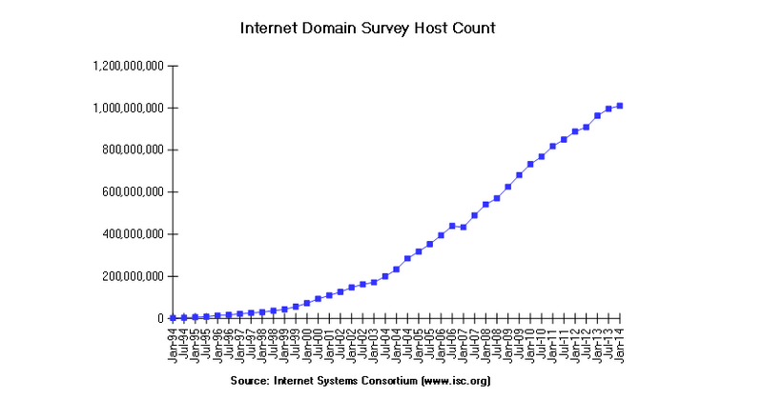
Internet Host Count
Internet presentation
Notes:
https://www.isc.org/services/survey/

Slide 13


Questions ?

Slide 14
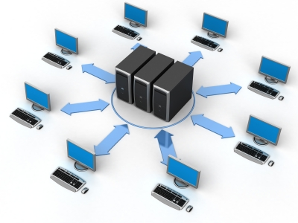
Client - Server
Web development

Slide 15
The HTTP protocol
Client - Server
HyperText Transfer Protocol
Communications protocol developed for the Web
Request/Response protocol
Client (browser)
Server (Web server)
Data transfer between a browser and a Web server
Stateless
Other protocols: FTP, POP, SMTP…

Slide 16
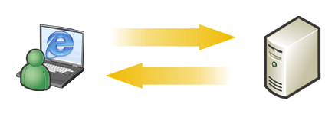
The HTTP protocol
Client - Server
The client transmits HTTP requests to the Web server to reach a resource.
1
The Web server answers at the request of each client by a HTML page or other resource.
2
1
2

Slide 17
HTTP request message
Client - Server
Composed of:
A request line composed of:
The request method used
The resource URI
The protocol and the version used
Several Headers
An empty line
An optional message body

Slide 18
HTTP request message
Client - Server
POST /en/html/index.html HTTP/1.1
Host: www.website.com
User-Agent: Mozilla/5.0 (Windows;en-GB; rv:1.8.0.11)
Accept: text/xml,text/html;q=0.9,text/plain;q=0.8,image/png,*/*;q=0.5
Accept-Language: en-gb,en;q=0.5
Accept-Encoding: gzip,deflate
Accept-Charset: ISO-8859-1,utf-8;q=0.7,*;q=0.7
Keep-Alive: 300
Connection: keep-alive
Content-Type: application/x-www-form-urlencoded
Content-Length: 39
name=MyName&male=yes

Slide 19
HTTP request methods
Client - Server
HTTP defines nine methods (or verbs):
GET: Request a representation of the resource
POST: Submit data to be processed to the identified resource
Data is included in the request body
HEAD: Like GET but return response headers only
PUT: Uploads a representation of the specified resource
DELETE: Deletes the specified resource
…

Slide 20
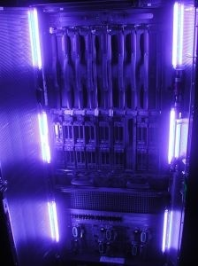
The Web Server
Client - Server
Receives HTTP requests and returns HTML pages or others (such as images, sounds, …)
Three servers dominate the market :
Apache HTTP Server (52.3%)
NginX (14.4%)
Microsoft IIS (11.3%)

Slide 21




Browsers
Client - Server
Three main browsers:
Internet Explorer
Mozilla Firefox
Google Chrome

Slide 22




Browsers
Client - Server
Other browsers…
Epiphany
Safari
Opera
. . .
Konqueror

Slide 23

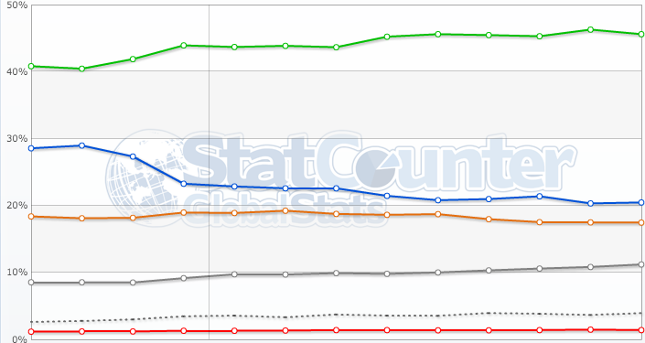
Browser use chart
Client - Server
IE
Chrome
Firefox
Safari
Opera
Others (dot)
From september 2013 to september 2014
Notes:
Source: http://gs.statcounter.com/

Slide 24
Questions ?

Slide 25

Exercices (1/2)
Client - Server
Try to send an HTTP request and watch the response
If you use Google Chrome:
Install Simple REST Client extension
https://chrome.google.com/extensions/detail/fhjcajmcbmldlhcimfajhfbgofnpcjmb
If you use Mozilla Firefox:
Install RESTClient extension
https://addons.mozilla.org/en-US/firefox/addon/9780/
If you use anything else, it’s time to change ☺
Or to look if another extension exists for your browser

Slide 26
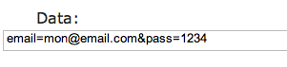
Exercices (2/2)
Client - Server
Try different request method on several websites
http://www.google.fr
http://www.facebook.com/
http://www.supinfo.com/
Try to send a POST request
To https://login.facebook.com/login.php
With your credentials in request body
Try with other websites of your choice

Slide 27

The W3C
Web development
Discovering internet normalizations

Slide 28
What is the W3C?
The W3C
Stands for World Wide Web Consortium
Normalization organism
Created in 1994
Managed by MIT, ERCIM and Keio university

Slide 29

Purpose of the W3C
The W3C
He promotes:
Web technologies compatibility (recommendations)
More information : http://www.w3.org/
He creates standards

Slide 30
Questions ?

Slide 31

The end
Web development
Thanks for your attention

